Slide 1

The Rise of AI Freelance Jobs in India
Exploring the booming AI freelance market in India, with diverse opportunities and challenges from 2025 to 2030.
AI-Generated Presentation • Confidential

Slide 2
Executive Summary
1
2
3
4
5
Market Growth
Productivity Boost
Specialized Roles
Skill Demand
Future Outlook
AI freelance market in India to reach $17 billion by 2027
70% of freelancers reported income increases by 2024
40% higher hourly rates for specialized AI roles
52% rise in AI-related tasks on platforms like Upwork
Robust growth driven by infrastructure improvements and global outreach
2

Slide 3
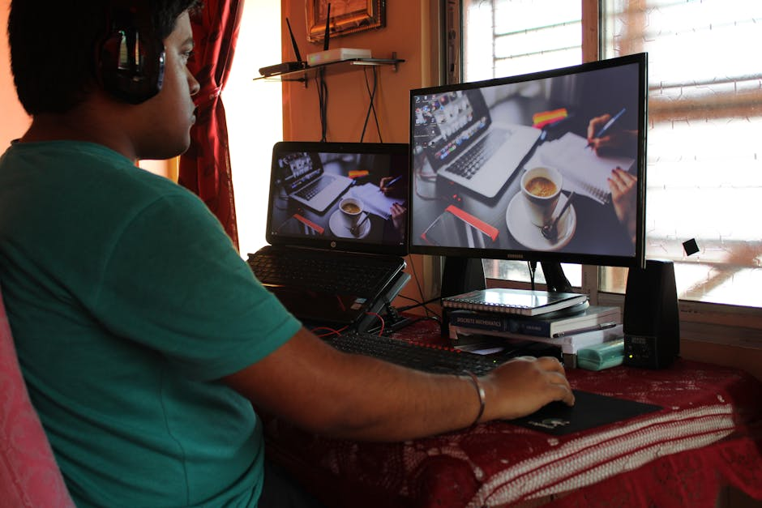
Growth Opportunities
1
India AI freelance market projected at $17B by 2027
Introduction to the AI-Driven Freelance Ecosystem in India
Key Drivers
2
Adoption of advanced tools like ChatGPT and Ola’s Kruti
Freelancer Productivity
3
70% reported income increases by 2024
Specialized Roles
4
High demand for prompt engineering and generative AI skills
Global Outreach
5
Expansion to U.S. markets driving growth
3

Slide 4
Key Statistics
INCOME INCREASE
HOURLY RATE PREMIUM
TASK GROWTH
MARKET SIZE
70%
40%
52%
$17B
reported by freelancers by 2024
for specialized AI roles
rise in AI-related tasks on platforms like Upwork
projected AI freelance market in India by 2027
4

Slide 5
Successes and Challenges
SUCCESSES
CHALLENGES
Global Competition: India-based freelancers compete with Eastern Europe on Upwork
Rural Freelancers: Facing challenges in accessing quality internet and technology
Skill Gaps: Regional disparities in access to quality education and training
Urban Freelancers: Benefiting from access to high-quality infrastructure and resources
Infrastructure: Improvements in infrastructure driving growth
Government Support: Initiatives to support rural freelancers and address skill gaps
5

Slide 6

Prompt Engineering
1
High demand for skilled prompt engineers
High-Demand AI Freelance Specializations
Generative AI
2
Growing demand for generative AI skills
AI Development
3
Increased demand for AI development services
Data Science
4
High demand for data science and analytics services
Cybersecurity
5
Growing demand for cybersecurity services
6

Slide 7
Future Outlook
01
02
03
04
05
Growth
Innovation
Diversification
Globalization
Skill Development
Robust growth driven by infrastructure improvements and global outreach
Increased adoption of advanced AI tools and technologies
Expansion into new markets and industries
Increased global competition and collaboration
Emphasis on upskilling and reskilling for freelancers
7

Slide 8

Skill Development
1
Focus on developing high-demand AI skills
Strategic Guidance for Aspiring AI Freelancers
Networking
2
Building a strong professional network
Personal Branding
3
Creating a strong personal brand
Marketing
4
Effective marketing and self-promotion
Continuous Learning
5
Staying up-to-date with industry trends and technologies
8

Slide 9
Platforms, Marketplaces, and Ecosystem Players
Upwork
Fiverr
Freelancer
Toptal
Leading platform for freelance work
Popular platform for freelance services
Platform for freelance work and contests
Platform for high-end freelance talent
9

Slide 10
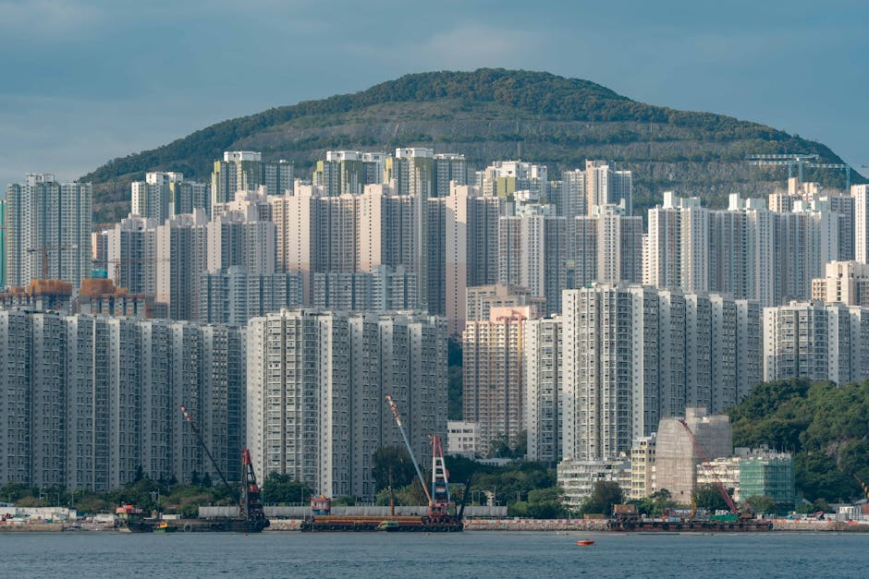
Government Initiatives
1
Support for rural freelancers and skill development
Policy Landscape and Institutional Support
Regulatory Framework
2
Development of a regulatory framework for the freelance industry
Taxation
3
Simplification of taxation for freelancers
Social Security
4
Provision of social security benefits for freelancers
Infrastructure Development
5
Investment in infrastructure development
10

Slide 11
India's AI Freelance Market Will Reach $17 Billion by 2027
Market growth driven by infrastructure improvements and global outreach
AI: 52% rise in AI-related tasks
Freelance: 70% of freelancers reported income increases
Growth: Robust growth projected for the next 5 years
11

Slide 12
Illustrative Case Studies and Success Narratives
01
02
03
04
05
Success Story
Growth Story
Innovation Story
Challenges Story
Lessons Learned
Indian freelancer achieves success on Upwork
Freelancer expands business to new markets
Freelancer develops innovative AI solution
Freelancer overcomes challenges to achieve success
Key takeaways from successful freelancers
12

Slide 13

Conclusion
→
Growth: Robust growth projected for the AI freelance market
→
Opportunities: High-demand AI skills and specializations
→
Challenges: Regional disparities and skill gaps
→
Future Outlook: Increased adoption of AI tools and technologies
→
Key Takeaway: India's AI freelance market will reach $17 billion by 2027
13

